Slide 1
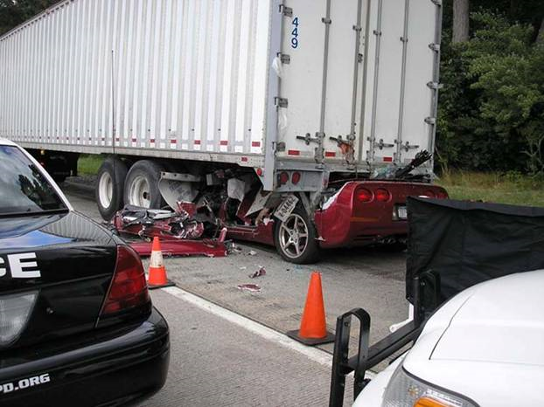
Driver Management Systems
By
Richard Buttenshaw ARM-P, CIC, CSP

Slide 2
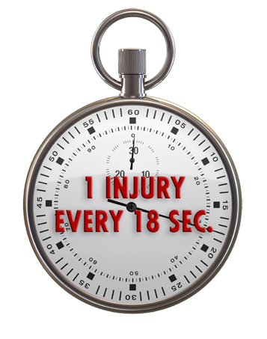
Driving Safety Statistics
Someone is injured every 18 seconds
Over 2 million injuries annually are disabling
A person dies in a crash every 11 minutes
Motor vehicle accidents are the most common cause of death
1 in 4 fatal work injuries involves a vehicle accident
Distracted Driving accounts for 25% of the crashes

Slide 3
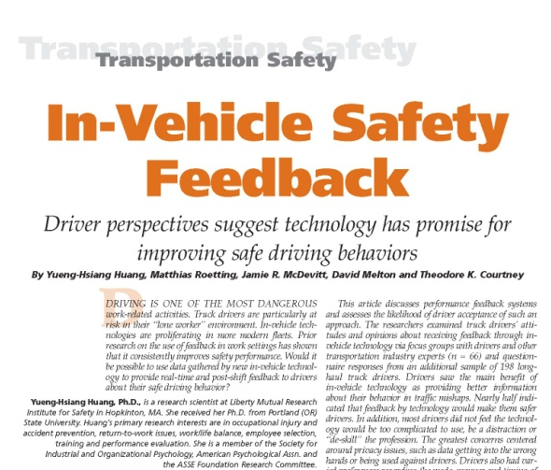
The Issues and Objectives
Distracted driver = Auto liability exposure
Driver behavior key in accident prevention
Understand Driver Management System (DMS) value

Slide 4
Important Questions
What are the business problems or risk issues that are motivating the interest and investment in a Driver Management System?
Why the growing use of third-party Driver Management Systems (DMS) to monitor driver behavior and vehicle performance?
How can driver monitoring systems can be used more effectively for safety and prevent crashes?

Slide 5
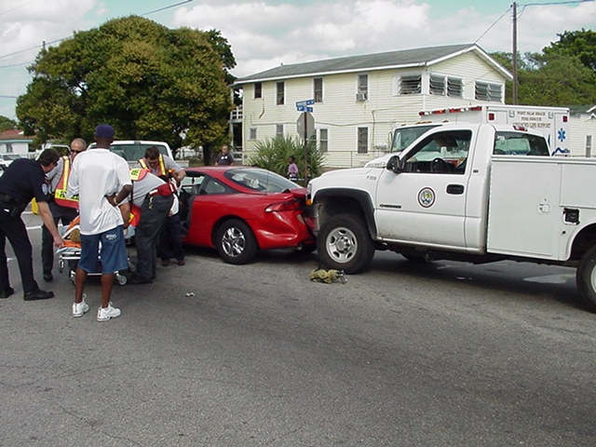
Crash Frequency and Severity

Slide 6
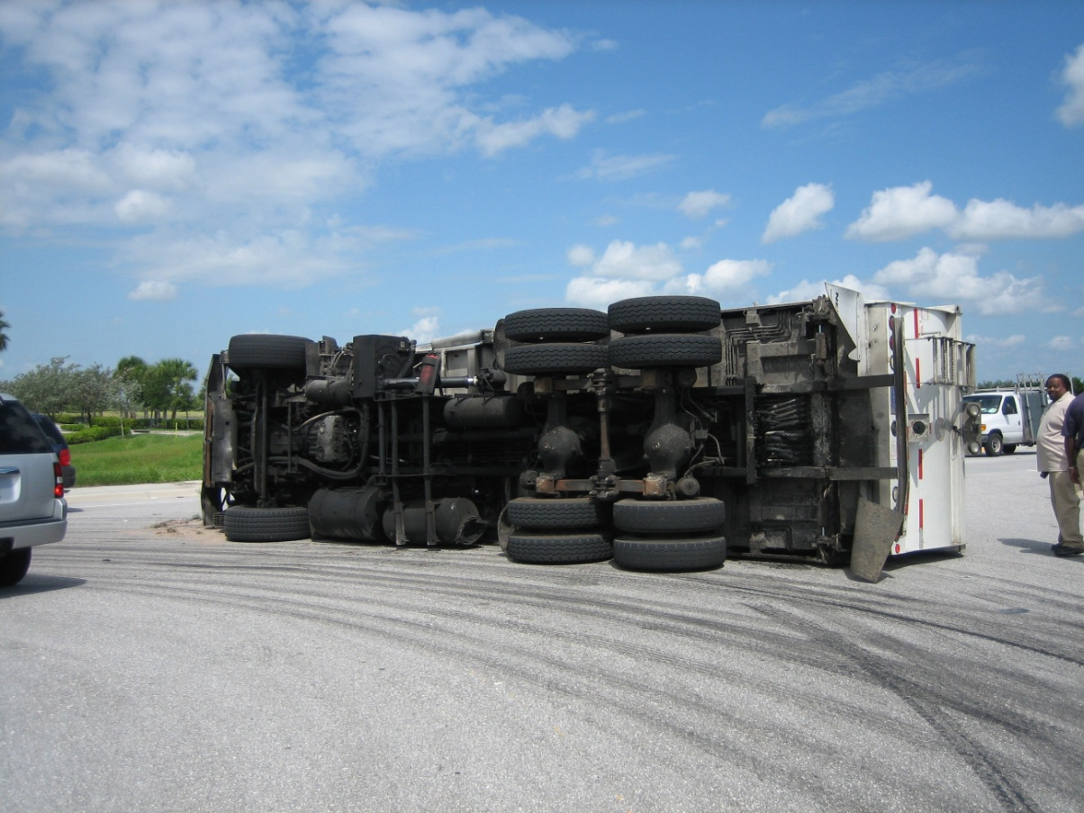
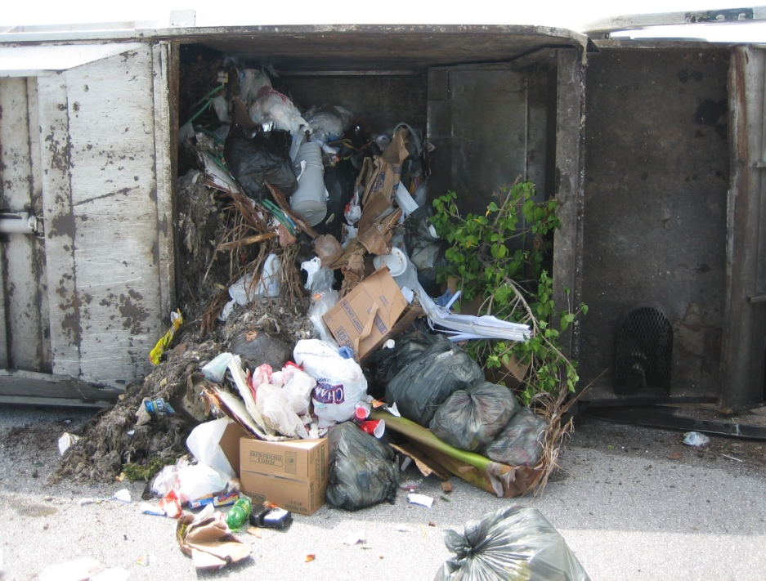
Vehicle and Property Damage

Slide 7
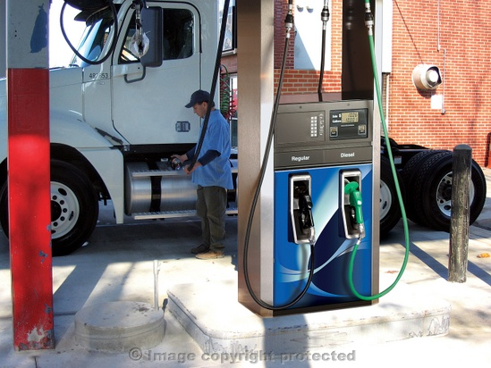
High Cost of Fuel

Slide 8
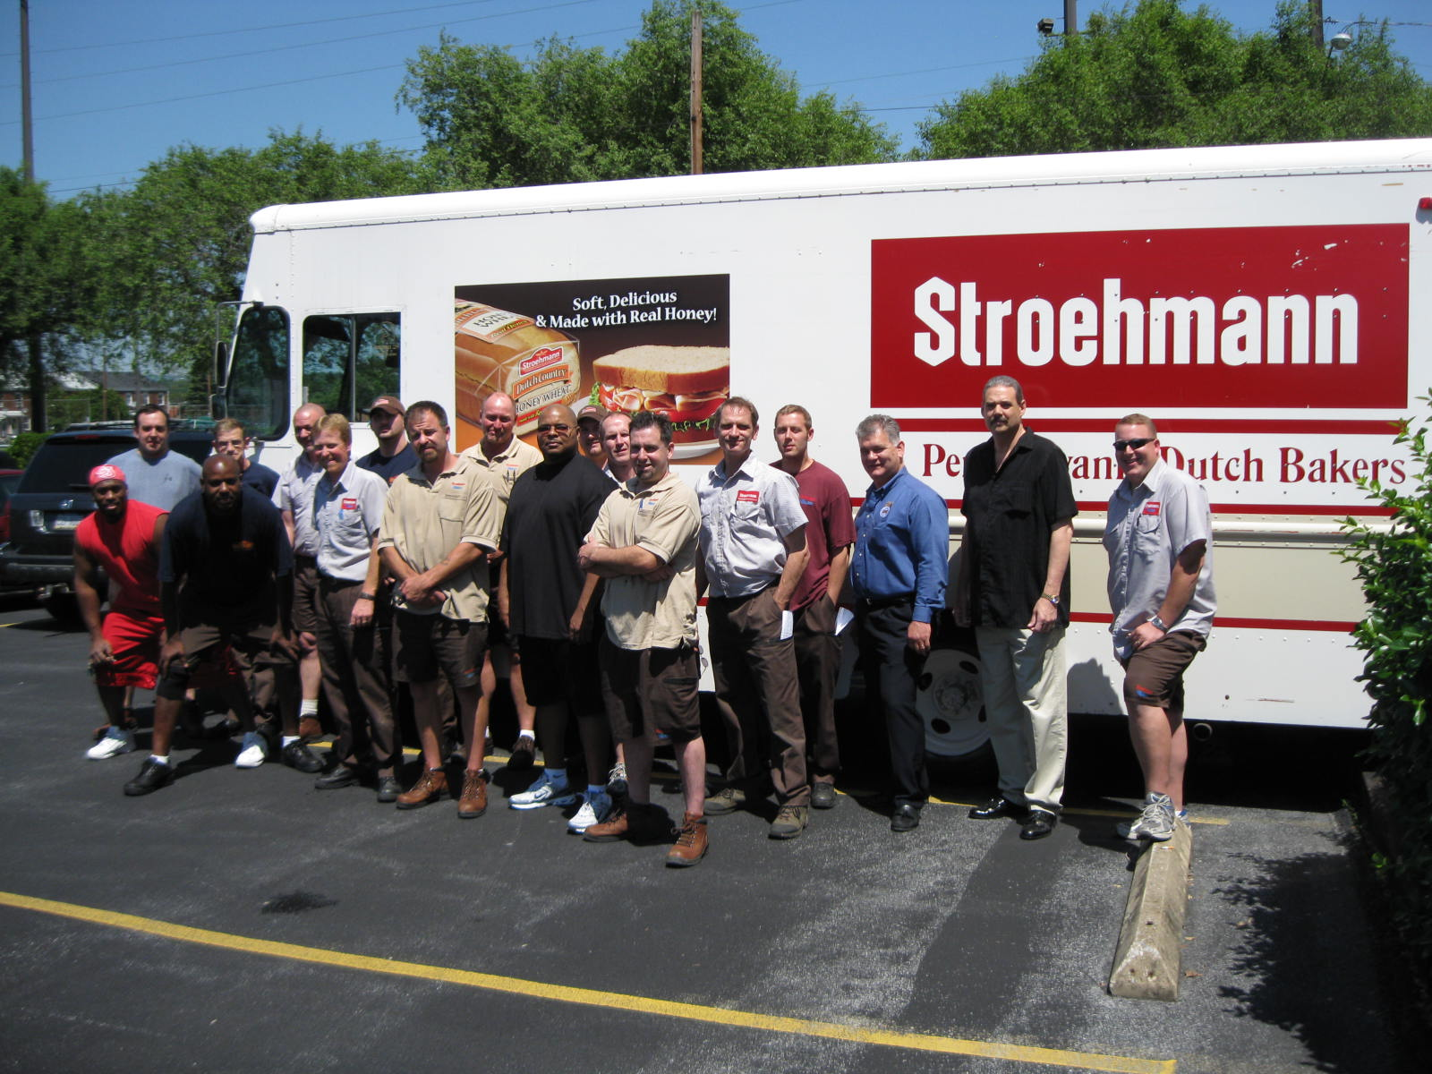
The Drivers are the Problem!

Slide 9
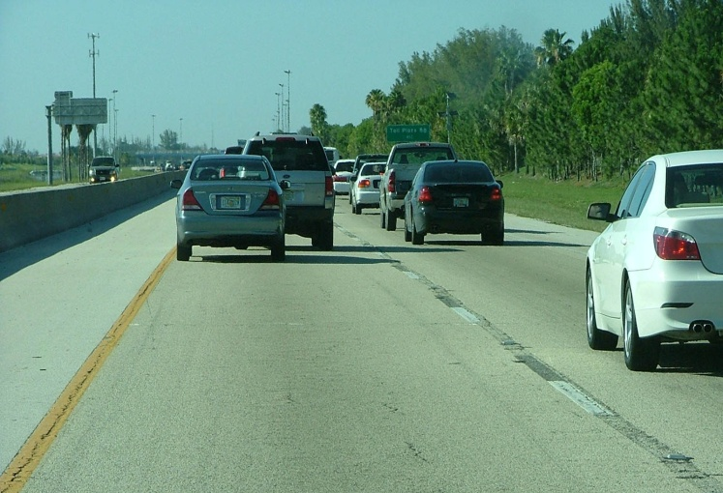
Driver Management Systems
Can Address
Hours of service records and reports
Maintenance and repair costs
Customer relations issues
Routing and efficiency
Risk management

Slide 10
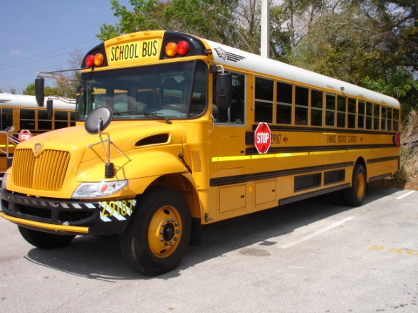
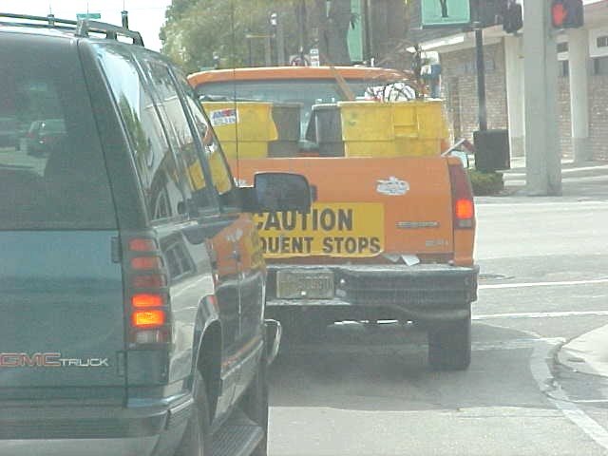
Exploring Technology
What are the common DMS available?
Why was the DMS installed?
Lessons we can learn from their use.

Slide 11
Driver Management
Systems
Public Call-in Services:
“1-866-Safety Is My Goal” or “How’s My Driving“
Onboard Telematics:
Automatically sense and report vehicle movement, forces and location.
Onboard Video Recorders: Sense sudden movement and capture driver actions and behaviors on video.

Slide 12
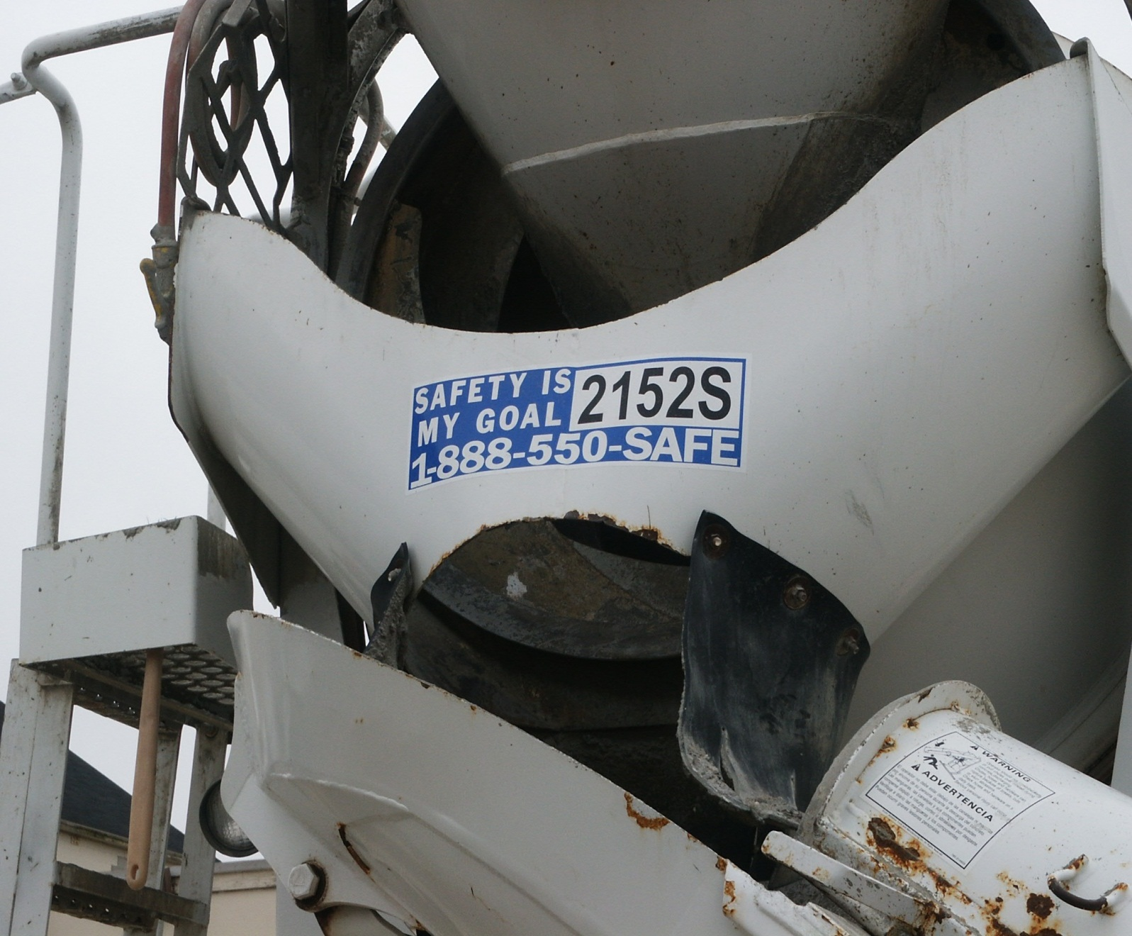
1-800 How’s My Driving?

Slide 13
Public Call-in Services
Be careful of the source of the call.
Log and investigate these calls
Common complaint calls include:
Ran a stop sign
Not wearing a seat belt
Talking on a cell phone while driving
Taking kids to the movies
Employee parked and taking a nap
Parked outside one house for long periods

Slide 14
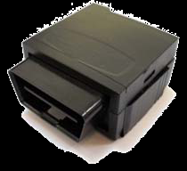
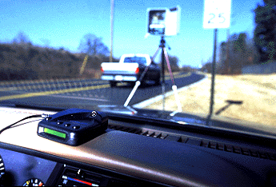
Onboard Telematics GPS/GSM/Gravitational Sensors

Slide 15
Onboard Telematics
Lots of systems on the market
Many now mainstream
Older systems just logged the data
Download the data once a day
New systems use cell technology for real time tracking
Pay monthly fee for service
Data tracked includes:
Location, speed, excessive acceleration and braking
Gravitational sensors detect a wreck has occurred
Some systems even “coach” the driver

Slide 16
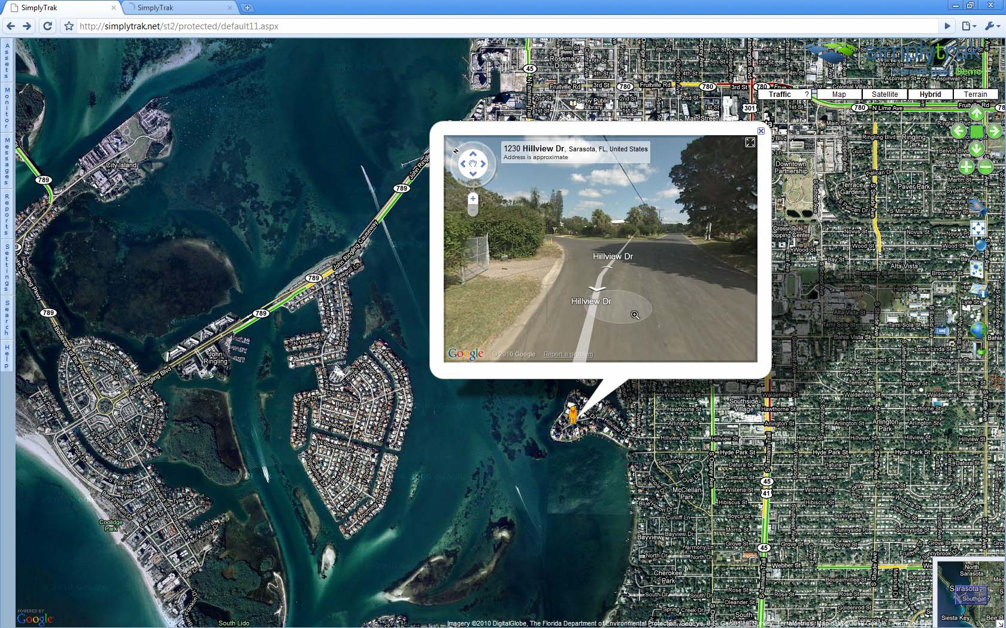
GPS – Telematics Report

Slide 17
Telematics Report
Supervisor can get real time alerts
Can be sent directly to your cell phone
Can be used for maintenance tracking too
Mileage, oil change, tire rotation
Area of operation reporting
Vehicle or driver based tracking?
Allows for driver recognition

Slide 18
Cell Phone Systems
Lots of standalone simpler systems
Fleet and family versions available
Potential problems:
Using the passengers phone
Pairing it to only one phone
Some use a “cradle” – compatibility issues?
“Complete jammers” – too strict?

Slide 19
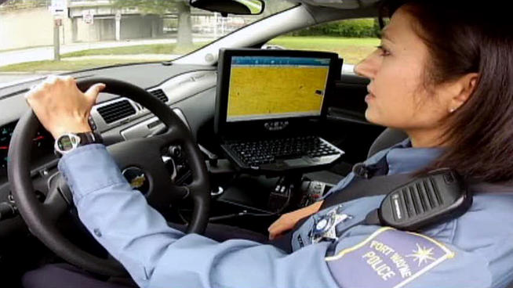
Dallas, Fort Worth Police Officers Allowed to Type While Driving
Police Departments Change Policy After Seven-Month Investigation
January 2013 NBC Local Report
www.nbcdfw.com/investigations/New-Technology-Could-Stop-Distracted-Officer-Crashes-179601451.html

Slide 20
Police Car Distractions
Technology for police cars?
Texting laws vs. internal policy
“Archangel II”
Fort Wayne PD helped develop the system
Shuts down laptop input functions above 15mph
Still have access to other data
Public pressure may change things

Slide 21
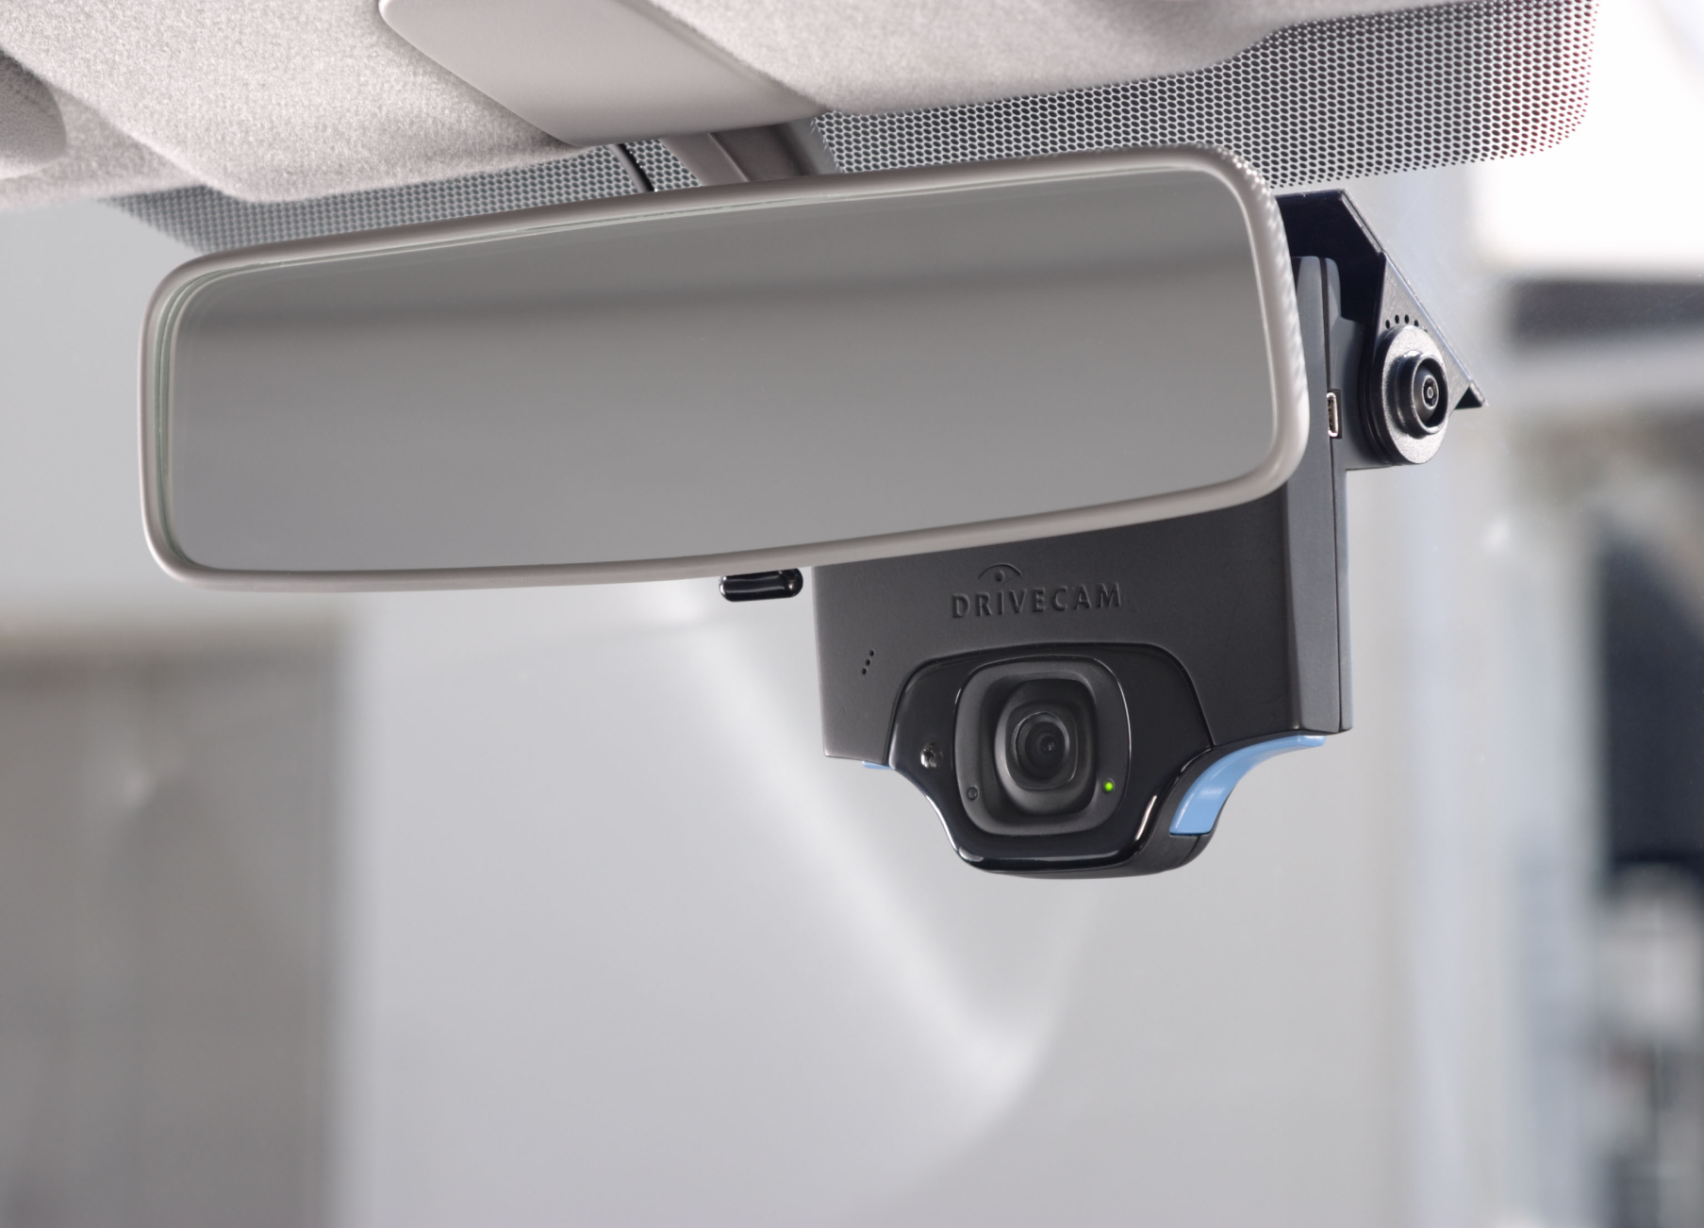
Video Monitoring

Slide 23
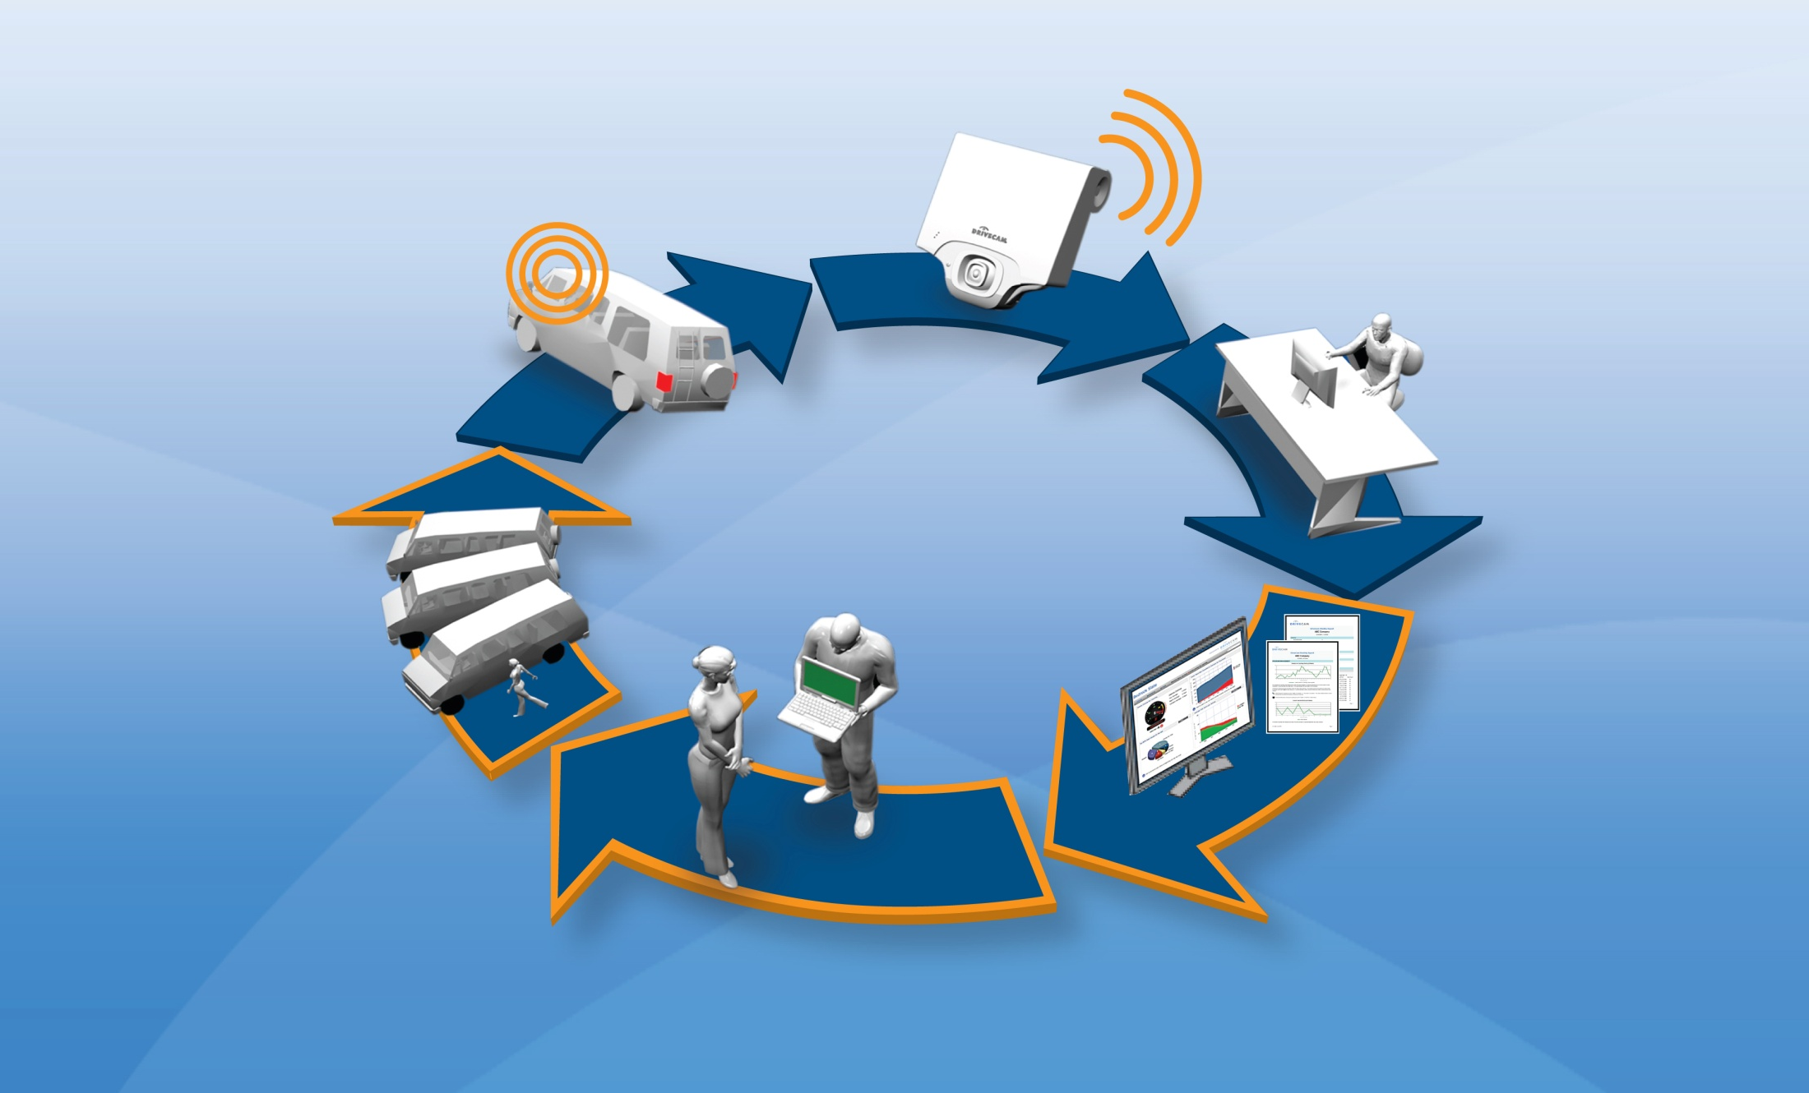
Video Monitoring Flow Diagram
Upload
triggered
event via Cell
2
1
Capture
risky
driving
3
Review, analyze and score
Driver Risk Management Program
6
Safer driver returns to the field
4
Clients access data via webs to view events, dashboards and reports
5
Coach driver

Slide 24
Video Sent To A Review Center

Slide 25
Sample Management Report

Slide 26
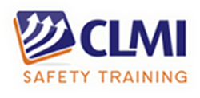
DMS Study
Study Conducted By Richard Pollock - CLMI Corporation (Training Developers)
Study Focused on Local Delivery Operations and Safety Issues Over the Past 20 Years
Direct Delivery Leadership Council (DDLC)
DDLC Focuses on Networking, Benchmarking, Best Practices and Real-World Solutions

Slide 27
DDLC – Direct Delivery Leadership Council

Slide 28
Size and Scope of the Study
Study Represents:
8,500 Locations
110,000 Vehicles
60% Straights Trucks, 54% Tractor/Trailer,
43% Light Trucks, 29% Step Vans
100,000+ Drivers
70% of Respondents Utilize a DMS

Slide 29
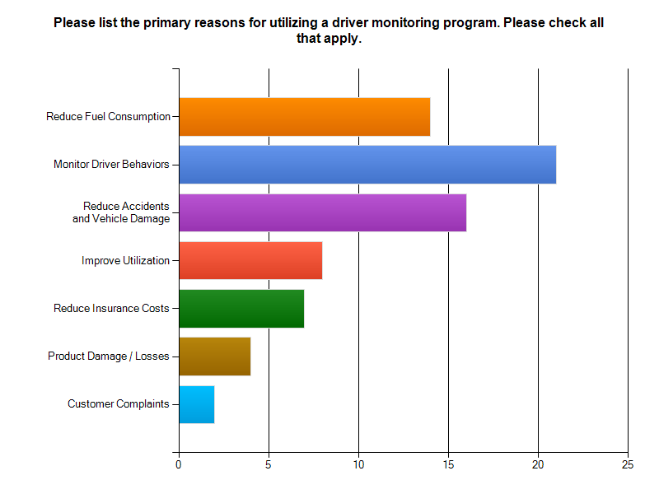

Slide 30
Study Conclusions
Respondents using DMS believe that their system is working.
Significant results can be expected in less than one year.
Supervisors/location managers are expected to train and coach drivers.
Coaching/communication training for trainers is lacking and ineffective.
In the driver Train–the-Trainer programs, 81% indicated a lack of training or the effectiveness.
Supervisory coaching and communications skills need to be improved.

Slide 31
DMS Study Results Positive Aspects
Positive Aspects:
Problem drivers are identified so coaching and follow up coaching instruction can occur.
Coaching can reinforce training principles.
Once “coached”, drivers usually do not have repeat infractions.
The use of a DMS can significantly reduce crashes and fuel consumption.
Can be used to exonerate a driver.

Slide 32
DMS Study Results Negative Aspects
Negative Aspects:
Nearly all DMS reports are negative in nature.
Behavior modification often based on discipline or negative consequences.
Lack of positive reinforcement limits or sustainability of the behavior change.
Discussion among peers tends to be negative.
Close-Call & Near-Miss reporting discouraged.

Slide 33
Starting a Driver Management System
Start with a pilot program and make it known
- Information gathering and not for discipline
- Use interdisciplinary work teams
- Create clearly defined goals for the program
- Validate training and practice coaching
Establish the DMS as an education system and not a discipline system
Establish “trust” with the drivers and eliminate the “fear” of what might happen.

Slide 34
Success Depends On Effective Coaching
Tips To Increase
Success With DMS
Constantly evaluate the quality of the coaching events between the drivers and supervisors.
Be willing to listen and learn from the drivers.
Always be “just” with discipline, and provide rewards for demonstrated safe behavior.
Create a culture of sharing: near-misses, closes-calls, great maneuvers, and overall successful Operations.

Slide 35
Accountability for Accidents
How to be consistent and fair with discipline:
Create a culture of accountability for at-fault accidents or equipment damage.
Get the safety committee to review each accident to get different views of attributing fault.
Develop a written policy detailing accountability.
Use for vehicle, equipment and property damage.
See Reference Document #AXIN-009 on www.losscontrol.org for a sample policy

Slide 36
Resources
www.distraction.gov
www.vtti.vt.edu
www.nsc.org/safety_road/Distracted_Driving/Pages/distracted_driving
www.drivecam.com
www.geotab.com
www.autohabits.com
www.inthinc.com
www.cellcontrol.com
www.txtblocker.com
www.srrsllc.biz

Slide 37
Other Resources
Impossible Belgium driving test video:
http://www.youtube.com/watch?v=HbjSWDwJILs
UK texting commercial (graphic):
http://www.youtube.com/watch?v=sKU7b6UaJsY
Best seat belt ad ever video:
http://www.youtube.com/watch?v=h-8PBx7isoM

Slide 38
Questions?

